Slide 1

Pilgrims of Hope: 60º Anniv. Dei Verbum
The Eucharist: Sacrament of Koinonia; 1 Corinthians 11
“The Eucharist makes the Church, and the Church makes the Eucharist,” Henri de Lubac.
“The Word of God and the Eucharist reveal, signify, and communicate the grace of God in Jesus Christ, Incarnate Word.” FJLC.
Felipe de J. Legarreta, PhD, Flegarr@luc.edu

Slide 2
1. Introduction.
The intrinsic and inseparable relationship between the Word of God and the Eucharist:
“The Church has always venerated the Sacred Scriptures as well as the very Body of the Lord, never failing to take from the table and distribute to the faithful the bread of life, both from the word of God and from the Body of Christ, especially in the Sacred Liturgy,” DV 21 (1965).
The term Hb Dabar highlights the inseparability between word and reality (cf. VD 53), so that the commemoration of the covenant means the actualization of the event being celebrated (Exodus, Eucharist).

Slide 3
“The intimate unity between Word and Eucharist is rooted in biblical witness (cf. Jn 6; Lk 24), confirmed by the Fathers of the Church and reaffirmed by the Second Vatican Council.”
“The discourse on bread [Jn 6:22-35] refers to the gift of God which Moses obtained for his people with the manna in the desert and which, in reality, is the Torah, the life-giving Word of God (cf. Ps 119; Pr 9:5).”
“Thus, in the mystery of the Eucharist it is shown what is the true manna, the true bread from heaven: it is the Logos [John 1] of God who became flesh, who gave himself for us in the paschal mystery,” (VD 54).

Slide 4
“The word of God, read and proclaimed by the Church in the liturgy, leads to the sacrifice of the covenant and the banquet of grace, that is, to the Eucharist, as its proper end. Word and Eucharist belong so intimately to each other that one cannot be understood without the other: the Word of God becomes sacramentally flesh in the Eucharistic event. The Eucharist helps us to understand Sacred Scripture, just as Sacred Scripture, in turn, illumines and explains the Eucharistic mystery. Indeed, without the recognition of the real presence of the Lord in the Eucharist, the understanding of Scripture remains incomplete” (VD 55; cf. Luke 24).
“The sacramentality of the word can be understood in analogy with the real presence of Christ under the species of consecrated bread and wine.[197] As we approach the altar and participate in the Eucharistic banquet, we actually receive the body and blood of Christ. The proclamation of the word of God in the celebration entails recognizing that it is Christ himself who is present and who comes to us to be received” (VD 56).

Slide 5
2. The Stories of the Institution of the Eucharist.
“For I received from the Lord the same which I delivered to you, that the Lord Jesus took bread in the night in which he was betrayed, and when he had given thanks, he broke it, and said, This is my body which is for you; do this in remembrance of me. In the same way he also took the cup after supper, saying, “This cup is the new covenant in my blood; do this, as often as you drink it, in remembrance of me. For as often as you eat this bread and drink this cup, you proclaim the Lord's death until he comes,” 1 Cor 11:23-26; with Lk, Antiochene tradition - Fitzsmyer.
“And as they were eating, he took bread, and when he had blessed it, he broke it, and gave it to them, and said, Take, this is my body. And he took a cup, and when he had given thanks, he gave it to them, and they all drank of it. And he said to them, “This is my blood of the new covenant, which is poured out for many. Truly I tell you, I will drink no more of the fruit of the vine until that day when I drink it new in the kingdom of God,” Mk 14:22-25.

Slide 6
“And as they were eating, Jesus took bread, and when he had blessed it, he broke it, and gave it to the disciples, and said, Take, eat; this is my body. And he took a cup, and when he had given thanks, he gave it to them, saying, “Drink from it, all of you; for this is my blood of the new covenant, which is shed for many for the forgiveness of sins. And I tell you that from now on I will drink no more of this fruit of the vine, until that day when I drink it new with you in the kingdom of my Father,” Mt 26:26-29; with Mk, Jerusalem tradition.
“When the hour had come, He sat down at the table, and the apostles with Him, and said to them, 'I have earnestly desired to eat this Passover with you before I suffer; for I say to you that I shall never eat it again until it is fulfilled in the kingdom of God. And having taken a cup, when he had given thanks, he said, Take this, and divide it among yourselves: for I say unto you, that from henceforth I will not drink of the fruit of the vine, until the kingdom of God come. And when he had taken bread, when he had given thanks, he broke it, and gave it to them, saying, This is my body which is given for you; do this in remembrance of me. In the same way he took the cup after supper, saying, 'This cup is the new covenant in my blood, which is poured out for you,'” Lk 22:14-20. Cf. Jn 6:26-71; 13:1-30.

Slide 7
3. 1 Corinthians 11.
Historical-Social and Religious Context of Corinth. The Christian community in Corinth was composed of Judeo-Christians and a majority from among the Gentiles who met in private homes to pray and celebrate the Eucharist (cf. Rom 16:5; 1 Cor 16:19). Religious, socio-cultural and economic diversity caused divisions among its members, especially when they prayed and shared meals. Paul wrote the letters to the Corinthian community, probably from Ephesus, between 53 and 56 A.D. to address these divisions and other issues raised by the Christians in Corinth:
Thesis of the Letter: “I exhort (parakaló, παρακαλῶ) you brethren (21 times in 1 Corinthians), in the name of Our Lord Jesus Christ, that you all say the same thing and that there be no divisions (σχίσματα) among you,” v. 10.

Slide 8
In the body of the letter, Paul responds, among other things, to the divisions caused by idol meat, i.e., food offerings offered to idols (10:1-11:1). Anticipating the theme of the Lord's Supper (11:17-34), Paul exhorts them:
“Flee from idolatry. I speak to you as to wise men; judge ye what I say: the cup of blessing which we bless, is it not communion (κοινωνία) in the blood of Christ? The bread which we break, is it not communion (κοινωνία) in the body of Christ? Since the bread is one, we who are many are one body (ἓν σῶμα); for we all partake (μετέχομεν) of the one bread,” 10:14-17.
Paul categorically concludes that precisely because of this, “They cannot drink the cup of the Lord and the cup of demons; they cannot partake (μετέχειν, cf. v. 17) of the table of the Lord and the table of demons, Or shall we provoke the Lord to jealousy? Are we stronger than He?” 10:21-22.

Slide 9
Then Paul responds to problems related to the Community Assemblies, 11:2-14:40, among them The Lord's Supper, 11:17-34, and on the spiritual gifts, 12:1-14:40.
Paul criticizes the Christians in Corinth for the way they celebrated the Lord's Supper: “I do not praise them...(ἐν τούτῳ οὐκ ἐπαινῶ)” 11,17.22 (cf. 11,2), since in coming together as the Church to celebrate the Lord's Supper there are divisions (σχίσματα) between factions and parties (cf. 1,10), exacerbating socio-economic divisions: while some eat and get drunk, others go hungry (11,17-22).

Slide 10
  Appealing to the tradition received and handed down (11:23; 15:1), Paul describes and enunciates the formula of the supper of the Lord Jesus (cf. Lk 22:19; Mk 14:22-24; and Mt 26:26-28). Following the Jewish tradition at Passover of giving thanks by recalling the wonders of God through the reading of Scripture, after giving thanks (εὐχαριστήσας) Jesus pronounced the words over the bread, “This is my body (σῶμα) which is for you; do this in remembrance of me (ἐμὴν ἀνάμνησιν);”
  Then over the cup, “This cup is the new covenant (ἡ καινὴ διαθήκη) in my blood; do this as often as you drink it in remembrance of me (ἐμὴν ἀνάμνησιν).
  Paul adds the eschatological dimension of the Lord's Supper, “For as often as you eat this bread and drink this cup, you proclaim the Lord's death until he comes,” 11:23-26.

Slide 11
  Finally, Paul draws some ethical and social conclusions from the meaning of the celebration of the Lord's Supper, inviting them to examine and judge themselves, so that “when you come together to eat, wait for one another. If anyone is hungry, let him eat at home, so that you will not come together for judgment. The rest I will settle when I come,” 11:27-34.
  While this command indicates especially the command to perform that liturgical gesture, the commemoration of the Lord's Supper, the command also indicates the existential gesture of taking-sharing-sharing after the example of Jesus, that is, the Lord's Supper implies imitating the life of Jesus who gives himself for us, for others. Hence the strong connection that Paul makes between the Lord's Supper and the banquets among Christians that demand koinonia, i.e. communion and solidarity.

Slide 12
  Finally, in the section on spiritual gifts (12:1-14:40), Paul exhorts them not to be a cause of divisions in the Church, the body of Christ (12:12-31).
  “For just as the body (σῶμα) is one, and has many members, but all the members of the body, though many, constitute one body, so also is Christ. For by one Spirit we were all baptized into one body, whether Jews or Greeks, whether slaves or free, and we were all given to drink of the one Spirit. For the body is not one member, but many. If the foot were to say: Because I am not a hand, I am not part of the body, it does not for that reason cease to be part of the body. And if the ear should say: Because I am not an eye, I am not part of the body, it does not for that reason cease to be part of the body. If the whole body were an eye, what would become of hearing? If the whole body were hearing, what would become of the sense of smell? Now God has placed each of the members in the body as it pleased him. And if they were all one member, what would become of the body? But there are many members, but one body... Now you are the body of Christ, and each one individually a member of it,” 12:12-27.

Slide 13
  Dialogue: QQ/AA.
  Breakup Groups
To whom is the commandment, “Do this in remembrance of me” addressed? What does “this” mean?
What are the meanings and implications of “body” (σῶμα) related to the Lord's Supper and to the Christian community as the “body” (σῶμα) of Christ in 1 Corinthians ?
How can we express and foster the Kononia of the Church as the body of Christ, as we partake of the body and blood of Christ in the Eucharist?

Slide 14
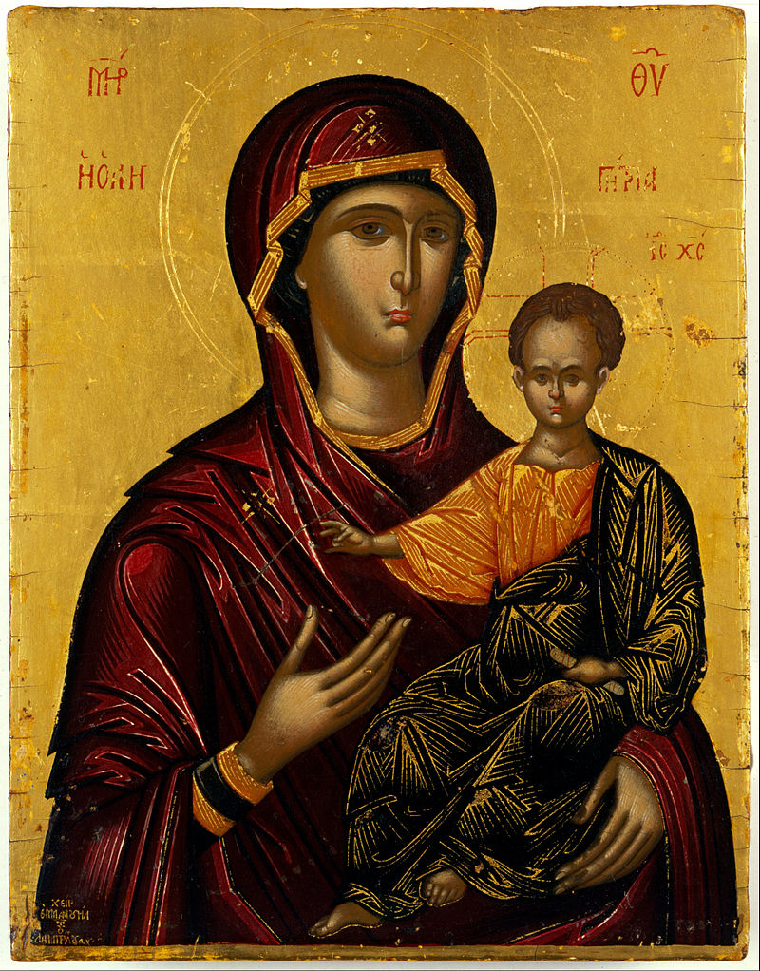
Together in Prayer
Our Lord Jesus Christ, we thank you for the gift of your Body and Blood that you have left us in the sacrament of the Eucharist.
We ask you through the intercession of your Mother, Mary Most Holy, to transform us into the same gift that we received in order to be witnesses of Communion and Hope in your Church, the Body of Christ. Amen.

